Slide 1
Shortest Path Problems
Directed weighted graph.
Path length is sum of weights of edges on path.
The vertex at which the path begins is the source vertex.
The vertex at which the path ends is the destination vertex.

Slide 2
Example
8
6
2
1
1
3
3
16
1
6
7
4
5
10
4
2
4
7
7
5
3
14
A path from 1 to 7.
Path length is 14.

Slide 3
Example
8
6
2
1
3
3
16
1
6
7
4
5
10
4
2
4
7
5
3
14
Another path from 1 to 7.
Path length is 11.

Slide 4
Shortest Path Problems
Single source single destination.
Single source all destinations.
All pairs (every vertex is a source and destination).

Slide 5
Single Source Single Destination
Possible algorithm:
  Leave source vertex using cheapest/shortest edge.
  Leave new vertex using cheapest edge subject to the constraint that a new vertex is reached.
  Continue until destination is reached.

Slide 6
Constructed 1 To 7 Path
8
6
2
1
3
3
16
1
6
7
4
5
10
4
2
4
7
5
3
14
Path length is 12.
Not shortest path. Algorithm doesn’t work!

Slide 7
Single Source All Destinations
Need to generate up to n (n is number of vertices) paths (including path from source to itself).
Dijkstra’s method:
  Construct these up to n paths in order of increasing length.
  Assume edge costs (lengths) are >= 0.
  So, no path has length < 0.
  First shortest path is from the source vertex to itself. The length of this path is 0.
Notes:
The solution to the problem consists of up to n paths. The greedy method suggests building these n paths in order of increasing length. First build the shortest of the up to n paths (I.e., the path to the nearest destination). Then build the second shortest path, and so on.

Slide 8
Single Source All Destinations
8
6
2
1
3
3
16
1
6
7
4
5
10
4
2
4
7
5
3
14
Path
Length
6
1
2
1
0
1
3
5
4
9
1
3
2
1
3
6
10
1
3
5
5
1
3
6
7
11

Slide 9
Single Source All Destinations
Path
Length
1
0
Each path (other than first) is a one edge extension of a previous path.
Next shortest path is the shortest one edge extension of an already generated shortest path.
1
3
2
1
3
5
5
1
2
6
1
3
5
4
9
1
3
6
10
1
3
6
7
11

Slide 10
Single Source All Destinations
Let d[i] be the length of a shortest one edge extension of an already generated shortest path, the one edge extension ends at vertex i.
The next shortest path is to an as yet unreached vertex for which the d[] value is least.
Let p[i] be the vertex just before vertex i on the shortest one edge extension to i.

Slide 11
Single Source All Destinations
8
6
2
1
3
3
3
16
1
6
7
4
5
10
4
2
2
4
4
7
7
5
3
1
14
[1]
[2]
[3]
[4]
[5]
[6]
[7]
d
0
6
2
2
16
-
-
14
p
-
1
1
1
-
-
1

Slide 12
Single Source All Destinations
8
6
2
6
1
3
3
16
1
7
5
6
4
5
10
4
2
2
4
7
5
3
1
14
1
3
[1]
[2]
[3]
[4]
[5]
[6]
[7]
d
0
6
2
16
5
5
-
10
-
14
p
-
1
1
1
3
-
-
3
1

Slide 13
Single Source All Destinations
8
6
2
1
3
3
16
1
7
5
6
4
5
10
4
2
4
4
7
7
5
3
1
14
1
3
[1]
[2]
[3]
[4]
[5]
[6]
[7]
d
0
6
2
16
9
5
-
10
1
3
5
6
-
14
p
-
1
1
5
1
3
-
-
3
1

Slide 14
Single Source All Destinations
8
6
2
1
3
3
16
1
6
7
4
5
10
4
2
4
4
7
5
3
1
14
1
3
[1]
[2]
[3]
[4]
[5]
[6]
[7]
d
0
6
2
9
5
-
10
1
3
5
9
-
14
p
-
1
1
5
3
-
-
3
1
1
2

Slide 15
Single Source All Destinations
8
6
2
1
3
3
16
1
6
7
4
5
10
4
2
4
7
7
5
3
1
14
1
3
[1]
[2]
[3]
[4]
[5]
[6]
[7]
d
0
6
2
9
5
-
10
14
1
3
5
10
12
p
-
1
1
5
3
-
-
3
4
1
1
2
1
3
5
4

Slide 16
Single Source All Destinations
8
6
2
1
3
3
16
1
6
7
4
5
10
4
2
4
7
7
5
3
14
1
3
6
[1]
[2]
[3]
[4]
[5]
[6]
[7]
d
0
6
2
9
5
-
10
-
14
12
11
p
-
1
1
5
3
-
-
3
4
1
6

Slide 17
Single Source All Destinations
Path
Length
1
0
1
3
2
1
3
5
5
1
2
6
[1]
[2]
[3]
[4]
[5]
[6]
[7]
1
3
5
4
9
0
6
2
9
5
-
10
-
14
12
11
-
1
1
5
3
-
-
3
4
1
6
1
3
6
10
1
3
6
7
11
Notes:
Can construct shortest paths from the computed p[] data.

Slide 18
Single Source Single Destination
Terminate single source all destinations algorithm as soon as shortest path to desired vertex has been generated.

Slide 19
Data Structures for Dijkstra’s Algorithm
The described single source all destinations algorithm is known as Dijkstra’s algorithm.
Implement d[] and p[] as 1D arrays.
Keep a linear list L of reachable vertices to which shortest path is yet to be generated.
Select and remove vertex v in L that has smallest d[] value.
Update d[] and p[] values of vertices adjacent to v.

Slide 20
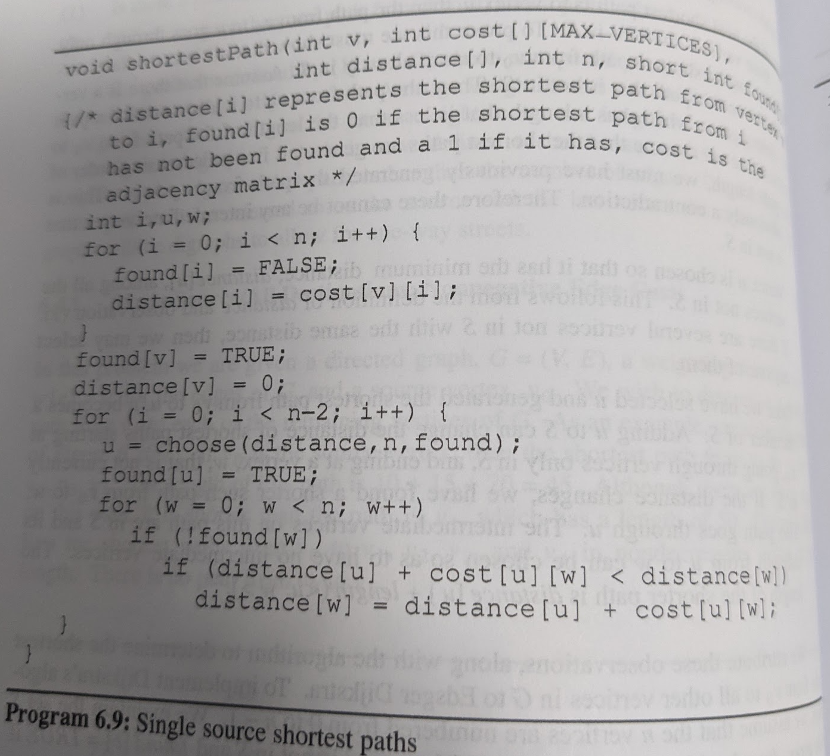
Complexity
adjacency matrix | min-heap | F-heap
O(n) | O(n log n) | O(n log n)
O(n) | O(e log n) | O(e)

Slide 21

Complexity
O(n) to select next destination vertex.
O(out-degree) to update d[] and p[] values when adjacency lists are used.
O(n) to update d[] and p[] values when adjacency matrix is used.
Selection and update done once for each vertex to which a shortest path is found.
Total time is O(n² + e) = O(n²).

Slide 22
Complexity
When a min heap of d[] values is used in place of the linear list L of reachable vertices, total time is O((n+e) log n), because O(n) remove min operations and O(e) change key (d[] value) operations are done.
When e is O(n²), using a min heap is worse than using a linear list.
When a Fibonacci heap is used, the total time is O(n log n + e).

